Slide 1
Classification of the gender of Big five survey
Submitted by: Mandy Rosemblaum (ID 305747230) and Efrat Kohen (ID 300385564)

Slide 2
Introduction
Big Five personality traits is a suggested taxonomy, or grouping, for personality traits developed from the 1980s onwards in psychological trait theory. The theory suggest five factors used in common language to describe the human personality:
openness (inventive/curious vs. consistent/cautious)
conscientiousness (efficient/organized vs. extravagant/careless)
extraversion (outgoing/energetic vs. solitary/reserved)
agreeable (friendly/compassionate vs. critical/rational)
neuroticism (sensitive/nervous vs. resilient/confident)
The goal of this project is to build a gender classifier that uses big five personality traits, age and country.

Slide 3
Previous work

Slide 4
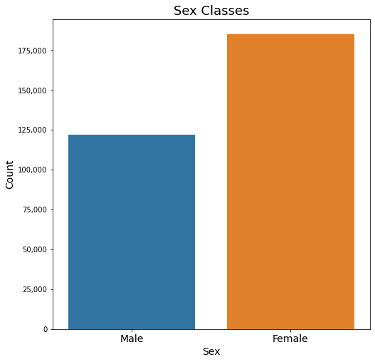
Data
307,313 recorded samples of male’s and female’s big five surveys.
Male: 122,164 samples
Female: 185,149 samples

Slide 5
Data features
Each sample has 8 features:
Country
Age
Sex: 1 = Male, 2 = Female
5 personality traits – values between 0 - 1
case_id | country | age | sex | Agreeable score | Extraversion score | Openness score | Conscientiousness score | Neuroticism score
1 | South Afri | 24 | 1 | 0.753333 | 0.496667 | 0.803333 | 0.886667 | 0.426667
3 | UK | 24 | 2 | 0.733333 | 0.680000 | 0.786667 | 0.746667 | 0.590000
4 | USA | 36 | 2 | 0.880000 | 0.770000 | 0.860000 | 0.896667 | 0.296667
5 | UK | 19 | 1 | 0.690000 | 0.616667 | 0.716667 | 0.636667 | 0.563333
6 | UK | 17 | 1 | 0.600000 | 0.713333 | 0.646667 | 0.633333 | 0.513333

Slide 6
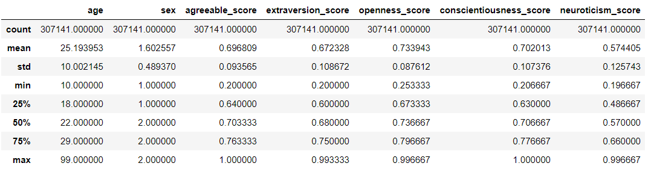
EDA - Mean and quantiles values
The data has172 nan values in country feature.
After removing rows with nan values here are the Mean and quantiles values of each numeric feature:

Slide 7
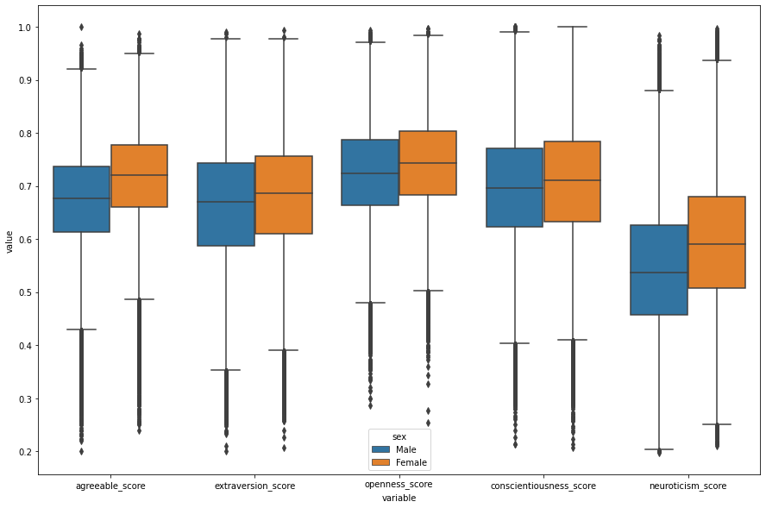
EDA – Box plot of personality traits
comparing Male and Female

Slide 8
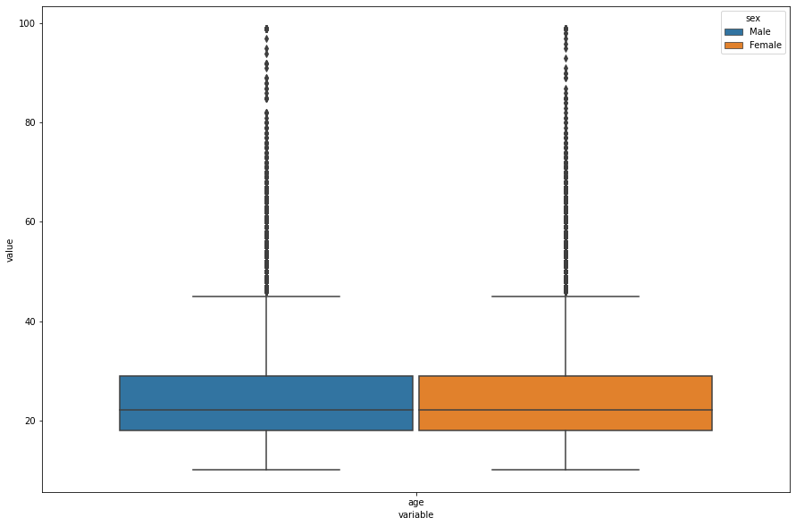
EDA – Box plot of age comparing Male and Female

Slide 9
EDA – Pairplot with Male and Female color map
תכניסי את הגרף אצלי זה בגוונים סגולים משום מה...

Slide 10
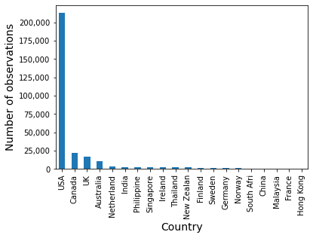
EDA – Top 20 countries histogram

Slide 11
EDA - Conclusions
Gender: The data is not balanced, there are more female observations than male.
Age: Most of the surveys are of young people in their twenties. It's not representative for the world's population.
Countries: USA has the majority of the observations (69%) and only 11 more countries has more than 0.5% of the observations.
Personality traits: All the personality means of female are a bit higher than male, especially neuroticism and agreeable.

Slide 12
Preprocessing
according to the exploratory data analysis we decided to:
Balance the data by gender
With one-hot encoding we gave a specific feature for only countries with significant amount of surveys (more than 0.5%) and all the other countries gather together to one feature 'other'.
Normalize the data
Add new features of multiplication of any two personality scores.
We tried to use PCA for dimensionality reduction, due to simalarity of personality traits distributions, but decided not to use it has the results didn't show beneficial output.
We tried to use K-means in order to see if there is a 'cultural' diversety (by countries regions), but decided not to use it has the results didn't show beneficial output.

Slide 13
Modeling
We decided to compere between two models:
Logistic regression
Gradient Boosting
The models run on three different 'data' in order to understand the preprocessing influence on the results:
raw_data: the original data without NaN and with significant countries one-hot encoding and normalization.
balanced_data: downsampled femal's observations from raw_data to match population's gender distribution.
balanced_interacted_data: balanced_data with new features of multiplication of any two personality scores.
The data divided to Training set: 80% and Test set:20%

Slide 14
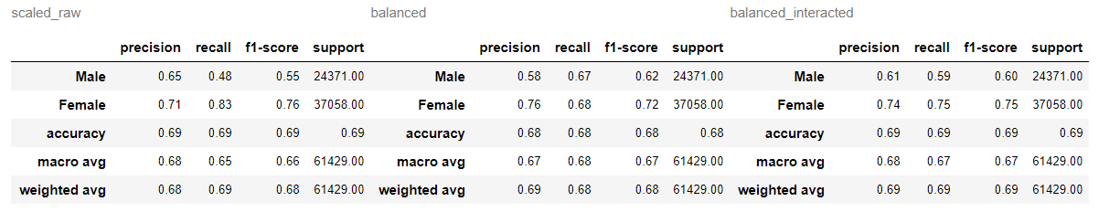
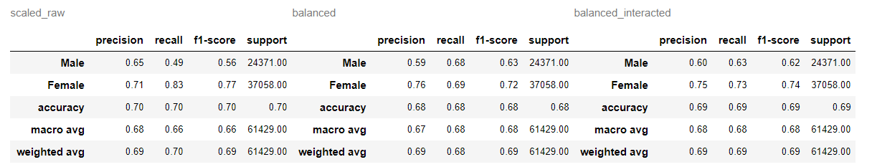
Results – Precision, Recall, F1-score
Logistic regression:
Gradient boosting:

Slide 15
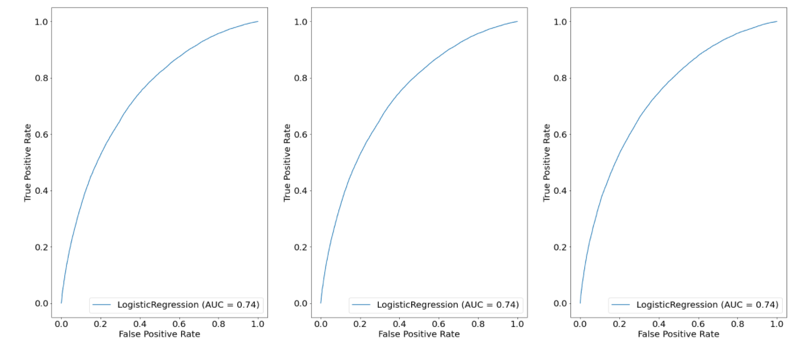
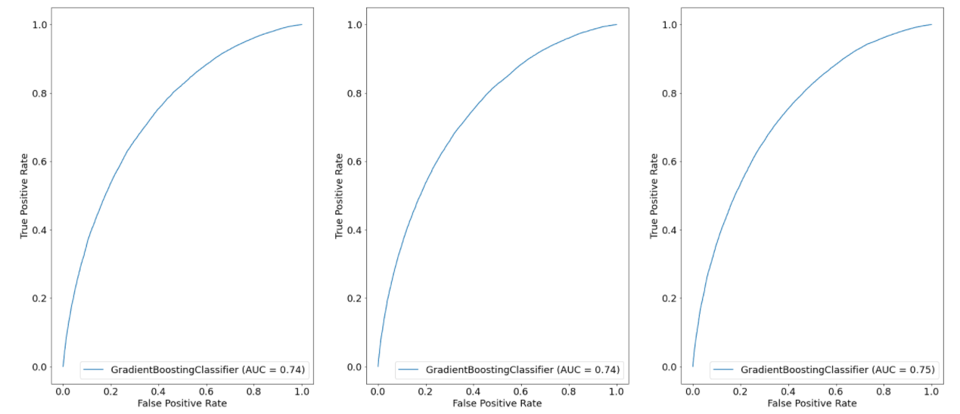
Results
– ROC curve
Logistic regression:
Gradient boosting:

Slide 16
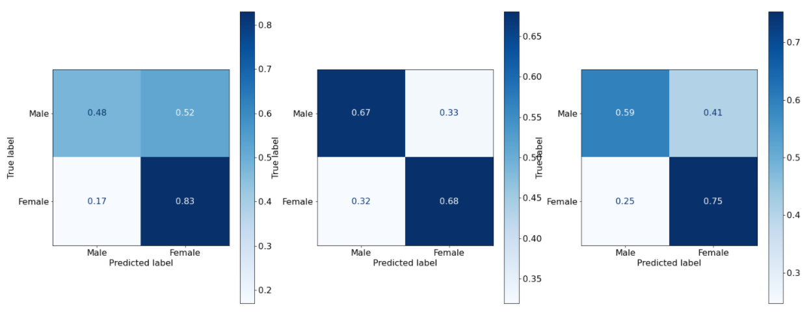
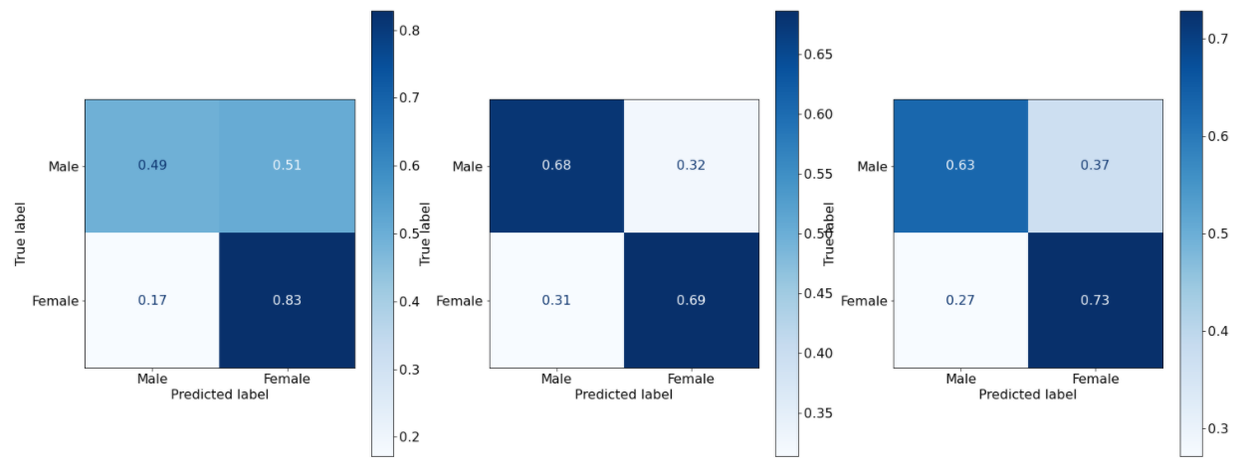
Results – Confusion matrix
Logistic regression:
Gradient boosting:

Slide 17
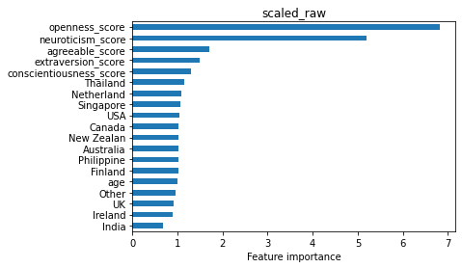
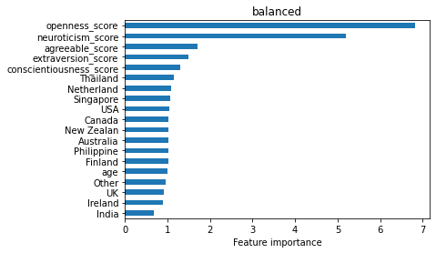
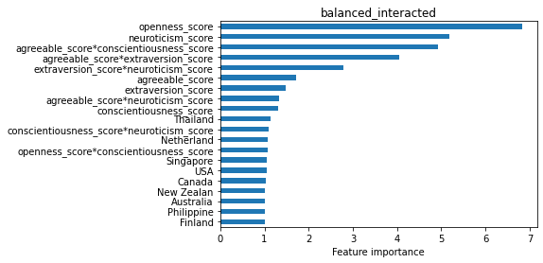

Explainability – Logistic regression
Calculated by:

Slide 18
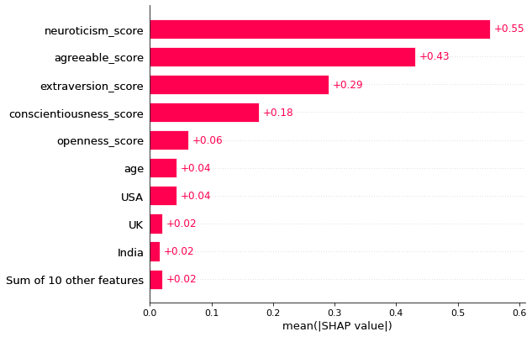
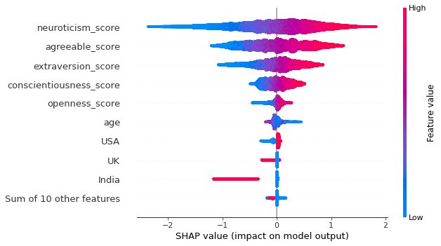
Explainability – Gradient Boosting - Shap
Scaled raw data

Slide 19
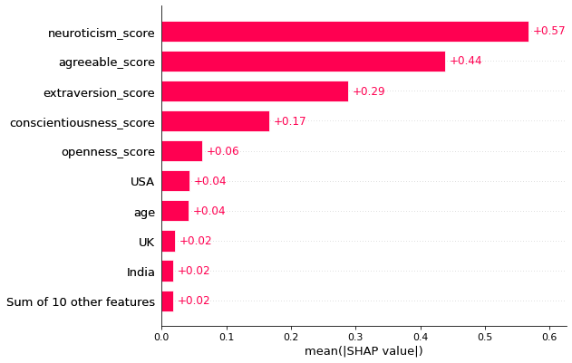
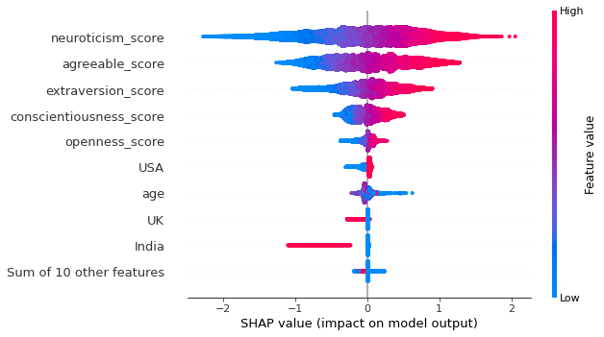
Explainability – Gradient Boosting - Shap
Balance data

Slide 20
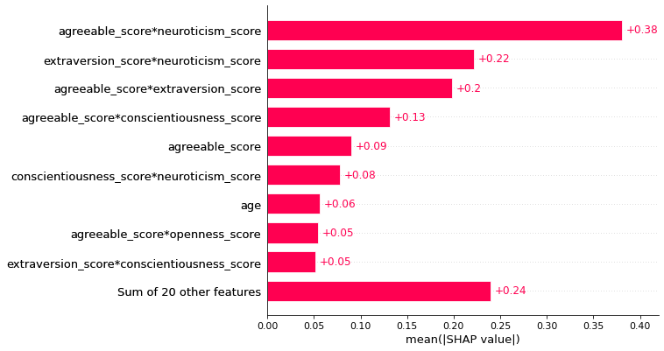
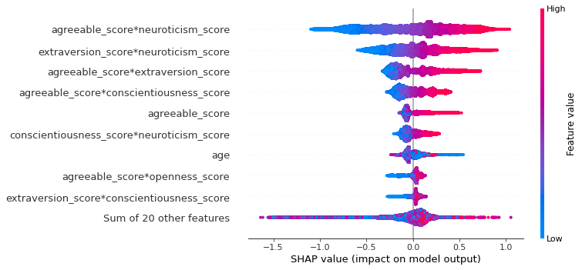
Explainability – Gradient Boosting - Shap
Balance Interacted data

Slide 21
Conclusions – ROC curve
We learn that…

